Slide 1

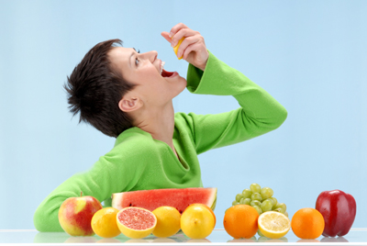
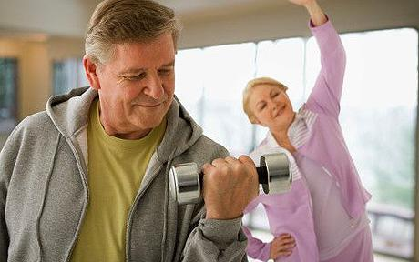
HEALTHY
WEALTHY
WISE

Slide 2


Life few decades back and today….

Slide 3
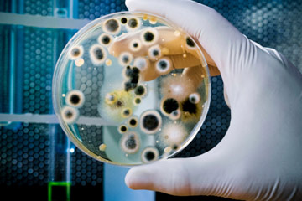
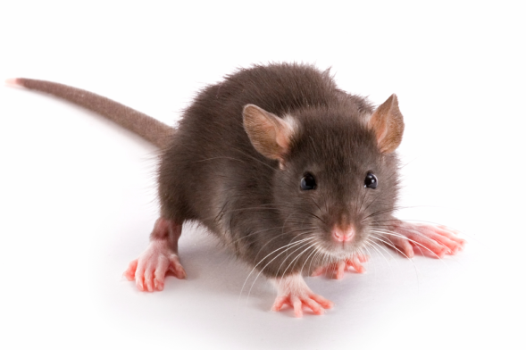
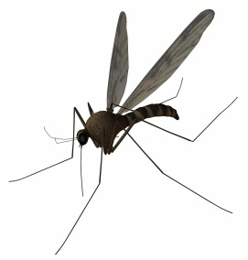
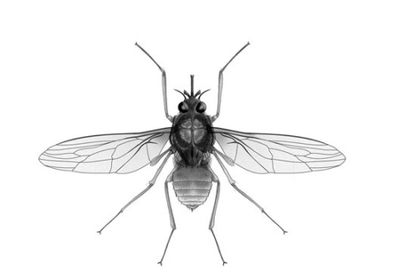
Common Health Concerns
PAST
MALARIA
TUBERCOLOSIS
WHOOPING COUGH
DIPHTHERIA
SMALL POX / CHICKEN POX
PLAGUE
FLU
CHOLERA
PRESENT
CARDIO VASCULAR DISEASE
CANCER
DIABETES
HYPERTENSION
OSTEOPOROSIS
ALZHEIMERS
STROKE
ASTHMA
OBESITY
ARTHRITIS
Cause : Micro organisms
Cause : Lifestyle – The Way we live

Slide 4
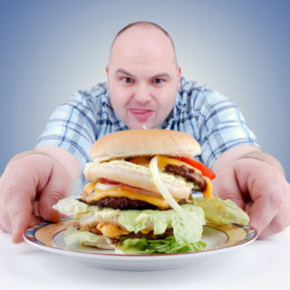
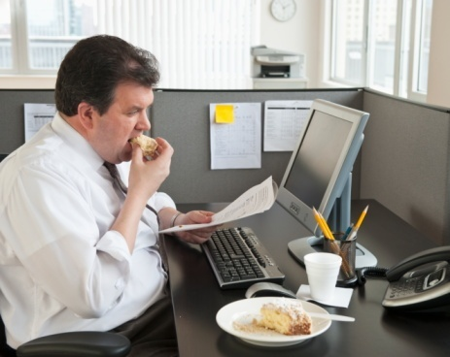

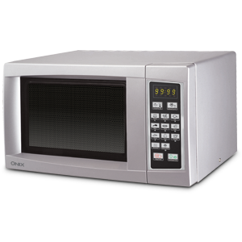
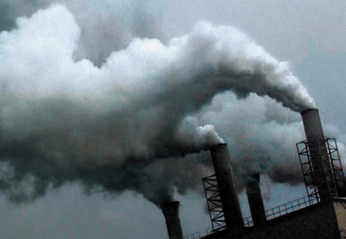

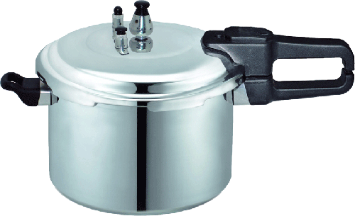

Why are we not HEALTHY ?
Poor eating habits (Junk foods)
Sedentary Lifestyle
High Stress levels
Pollution
Modern Cooking Methods
High Radiation levels

Slide 5
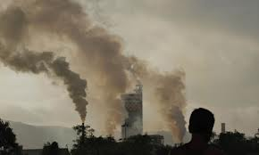

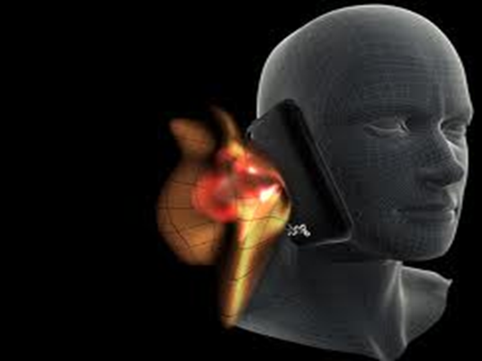
TOXINS FROM ENVIRONMENT
AIR POLLUTION
Air pollution is thought to be the cause for 1 in 10 deaths due to Lung Cancer
Environmental pollution threatens human health. Air pollution in cities causes a shorter lifespan for city dwellers.
WATER POLLUTION
Studies show that the alarming rate of increase in water pollution has affected millions of lives. More than 780 million people do not have access to clean water.
RADIATION
Radiation breaks down water in living cells into dangerously reactive free radicals which subject our bodies to a continual assault, attacking essential molecules of life such as DNA
and proteins.

Slide 6
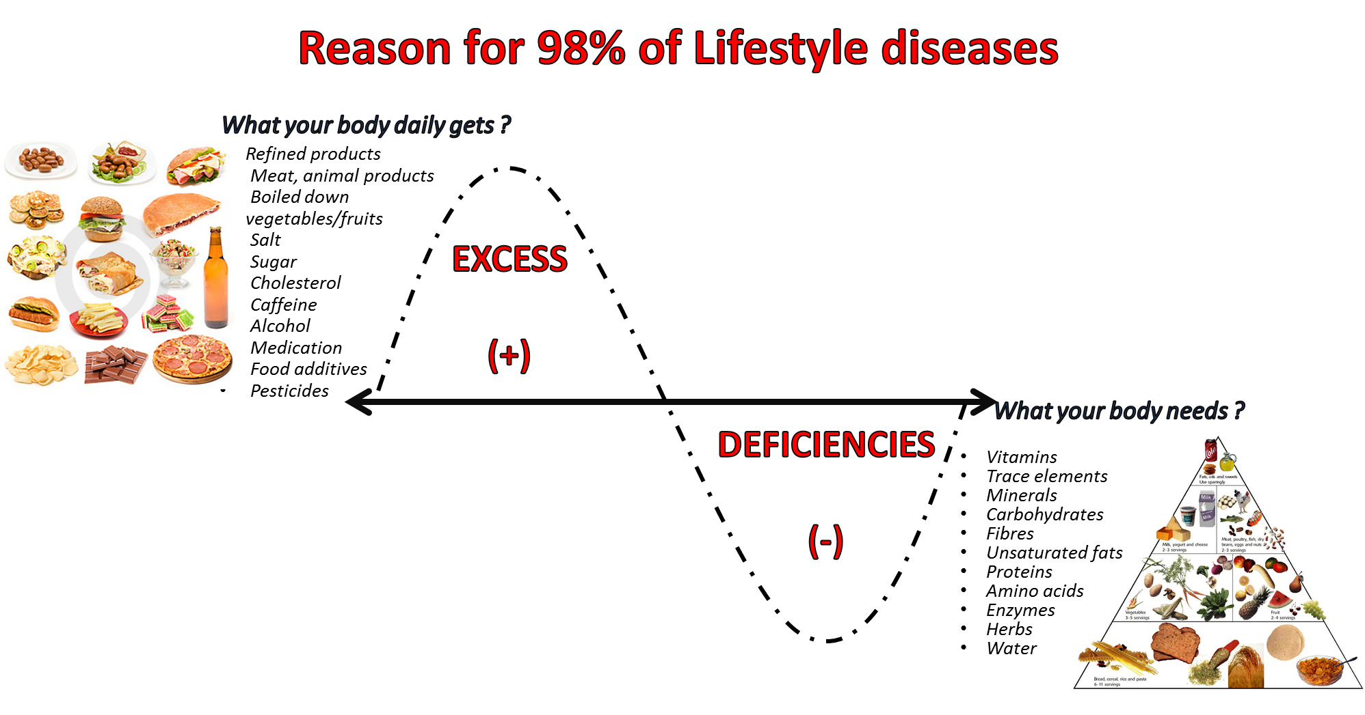
WHAT WENT WRONG ?
Earlier the food what we ate was as good as Medicine But, Today the food what we eat is as good as Slow poison.

Slide 7
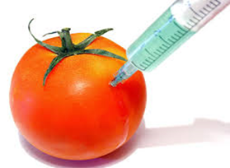
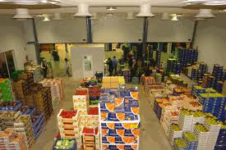
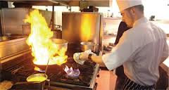
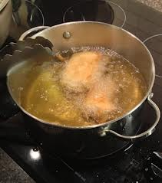
Demand Vs Supply is low - LACK OF NUTRIENTS
Your body don’t get the right nutrients from today’s diet ;
Low Nutrient levels in soil
Genetically modified crops
Toxic pesticides from GM food crops found in unborn babies. Toxic pesticides which are implanted into genetically modified food crops have lodged in the blood of pregnant women and their unborn babies, research shows. - (Times of India)
Storage & Transport
Fruit and vegetables travel thousands of miles to reach supermarkets.
Food that we assume is fresh and nutritious is often quite the reverse.
Ex:Spinach stored at room temperature loses between 50 and 90 percent of its vitamin C within 24 hours of being picked.
Cooking Method
Cooking veggies for a long period of time, or at a high temperature can destroy the nutrients, including those in the liquid

Slide 8
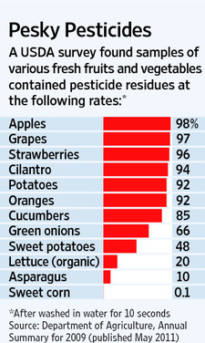
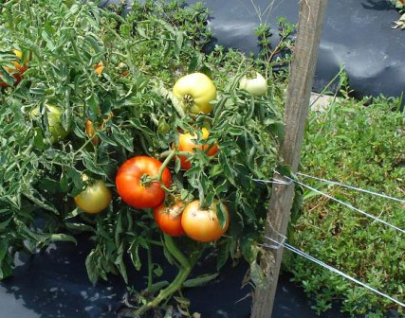
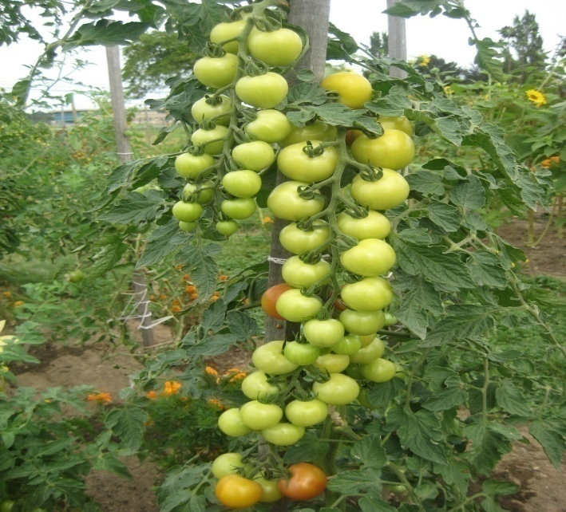
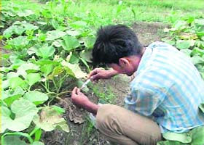
In the PAST
food was GROWN
TODAY food is MANUFACTURED
UNETHICAL PRACTICES
to increase output.

Slide 9
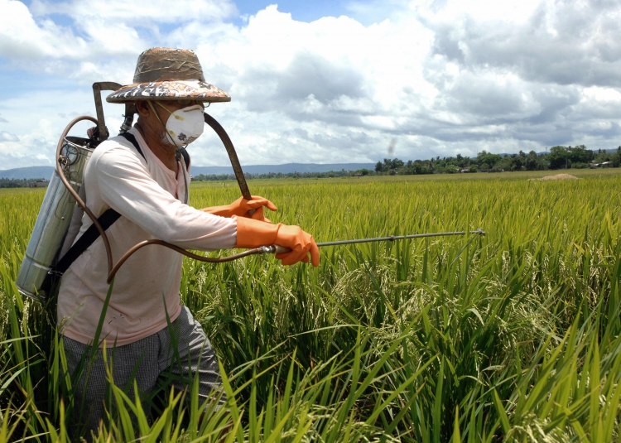
ACCUMMULATON OF TOXINS IN BODY
PESTICIDE
Chemicals in food what we eat
The World Health Organization estimates that there are 3 million
cases of pesticide poisoning each year and up to 220,000 deaths,
primarily in developing countries.
If it’s harmful to breathe, is it not harmful to eat ?

Slide 10


Slide 11
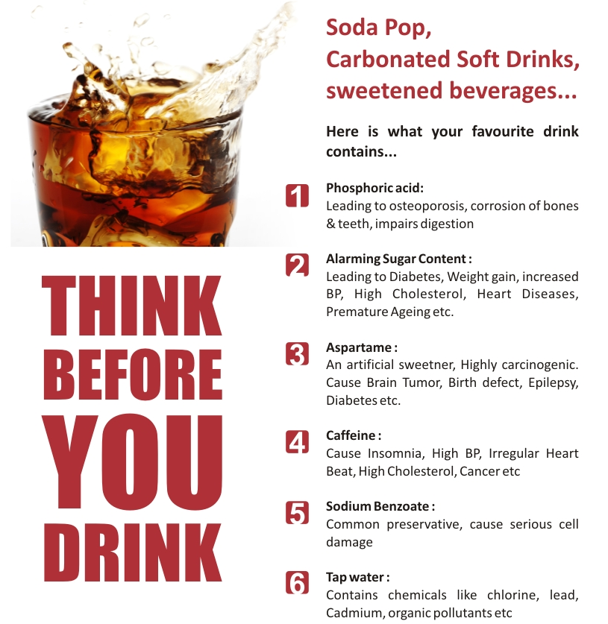
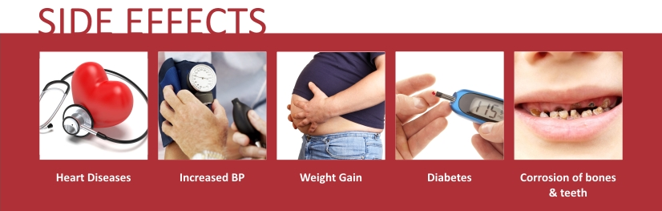
Human reports to FDA, too, have associated Aspartame to minor adverse reactions and life-threatening conditions that include:
Migraines
Change in vision
Nausea and vomiting
Insomnia / sleep problems
Abdominal and joint pains
Change in heart rate
Depression
Memory loss
Seizure
Brain cancer
You wouldn’t eat 22 packs of sugar,
why are you drinking them ?

Slide 12
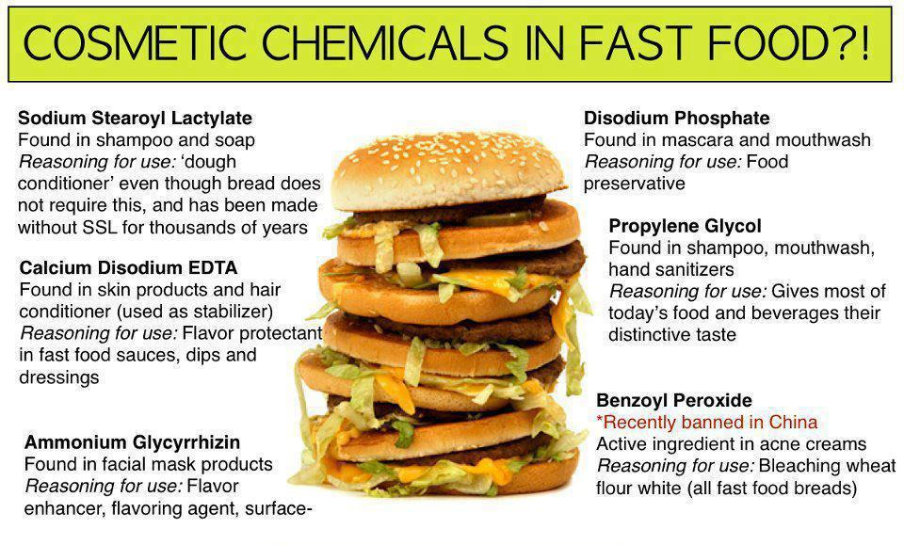
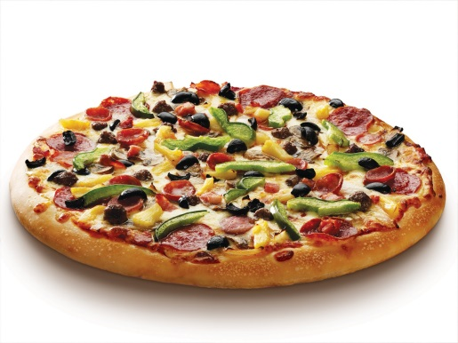



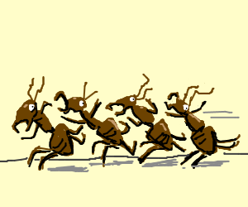
Shampoo
Now you know why flies & ants don’t come near your favourite food

Slide 13
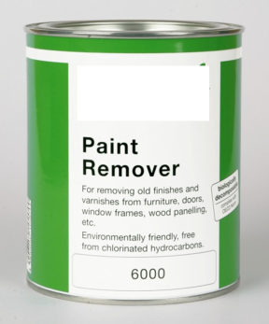

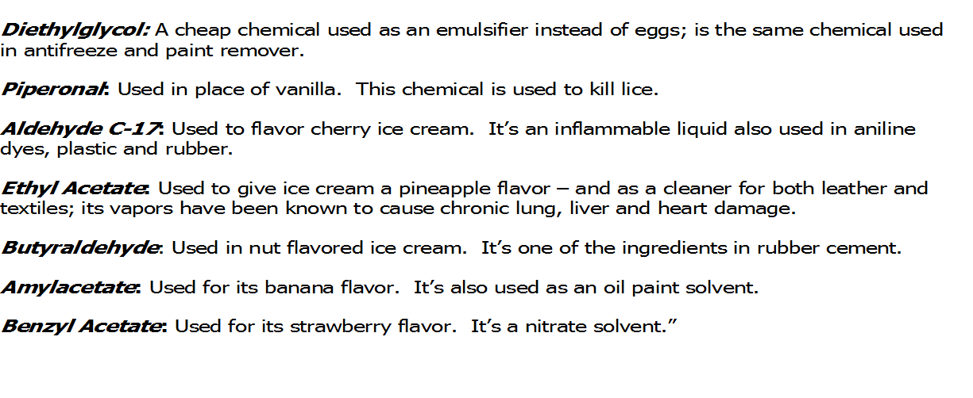

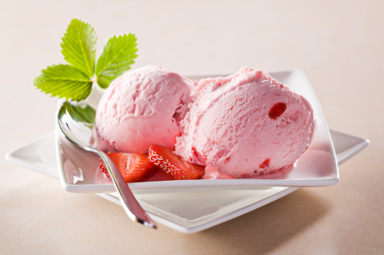
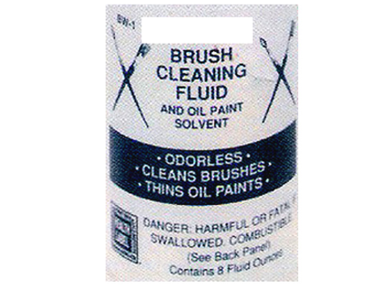


Chemicals in Ice Cream
What are these chemicals doing in the ice cream ?

Slide 14
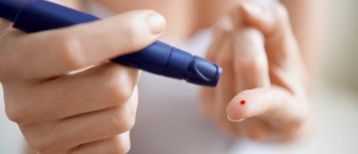
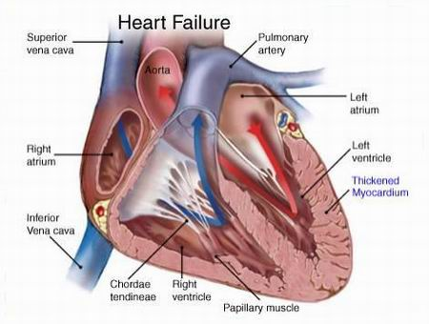
DIABETES :
1 out of 7 in India is a Diabetic
India having the highest number of diabetic patients in the world
the sugar disease is posing an enormous health problem in the country. Calling India the diabetes capital of the world.
Diabetes in India to touch 80 million by 2030
World Health Organisation
CARDIO VASCULAR DISEASES :
60% of Heart related deaths in the world will occur in India
Time Magazine
35% deaths in India due to cardiovascular diseases
Shimona Kanwar, TNN Jul 22, 2013, 03.04PM IST
Heart disease set to spike in India, especially in the south’
According to well-known radiologist Harsh Mahajan, by 2020 India will have more than 4.77 million deaths a year due to cardiovascular disease (CVD) and 2.58 million deaths due to coronary heart diseases (CHD).

Slide 15
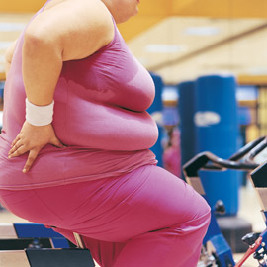
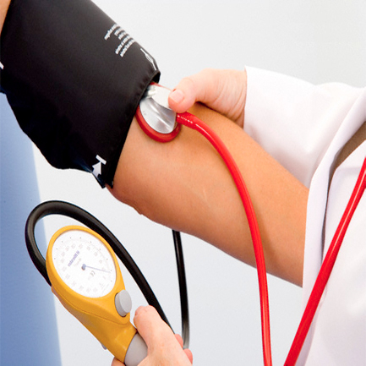
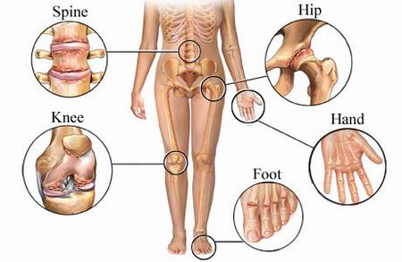
OBESITY:
Over 50% of Indian population will suffer from obesity in the coming ten years
HYPERTENSION:
35% of school children in urban areas suffer from hypertension
ARTHRITIS:
India has more people suffering from arthritis than entire
EUROPE & NORTH AMERICA combined

Slide 16
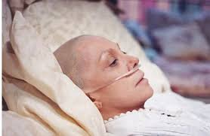
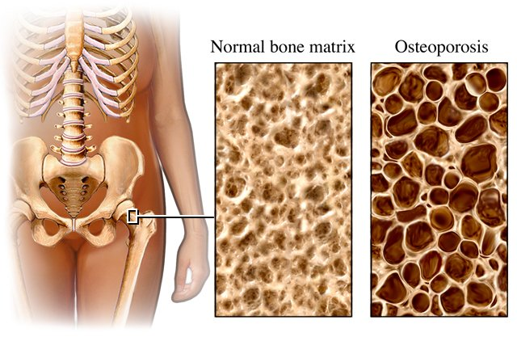
CANCER:
Cancer is the 3rd Largest Killer in India
In India, four lakhs die of cancer every year. The ministry data shows 25 lakh cancer patients in the country at any point in time. Cancer is the third biggest killer in India.
OSTEOPOROSIS:
Expected case of osteoporosis will increase by 250 million
by 2015
Based on 2001 census,approximately 163 million indians all the above age of 50,this is the expected case for osteoporosis which will increase to 250 million by 2015.
(Department of Endocrinology & Diabetes,New Delhi)

Slide 17


EARLY PUBERTY:
Puberty strikes as early at age 5 in bangalore – Times of India
Onset of puberty in girls has fallen by five years since 1920
Study: More U.S. girls starting puberty early
By Amanda Gardner, Health.com
August 10, 2010 -- Updated 0950 GMT (1750 HKT)
Girls hit puberty earlier than ever, and doctors aren't sure why
By Liz Szabo, USA TODAY
EARLY MENOPAUSE:
Menopause at age 20– Times of India
New urban scare: Menopause in 20s
Hetal Vyas TNN
'1 in 20 women' hit by early menopause: Doctors baffled at rising numbers of under-40s affected
By JENNY HOPE
UPDATED: 06:42 GMT, 7 July 2011

Slide 18

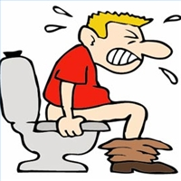
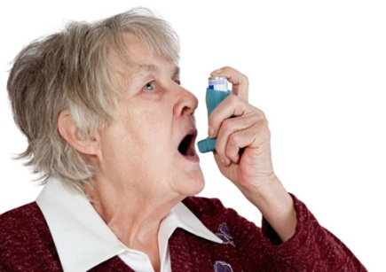


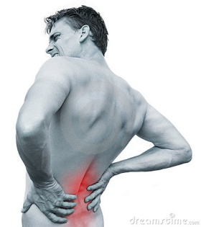
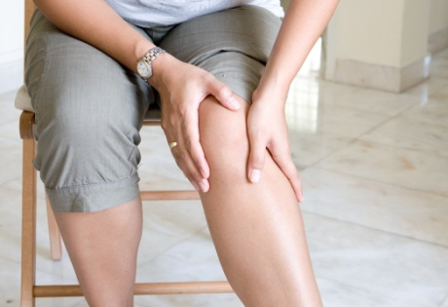
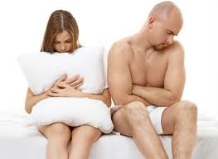
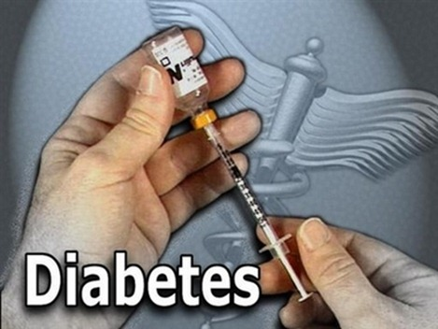
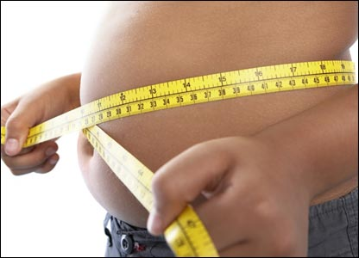
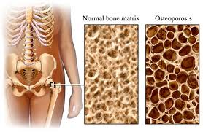
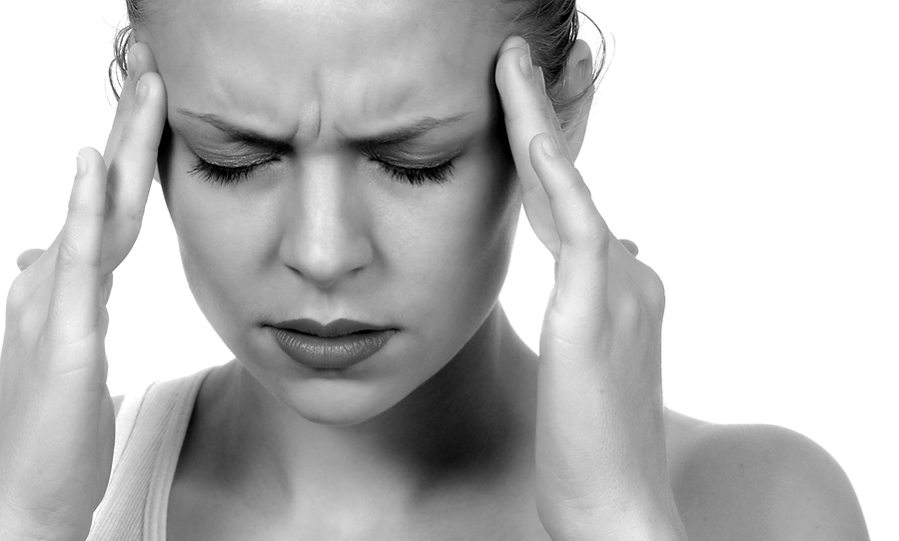
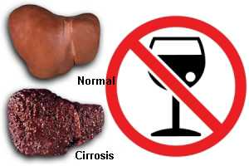

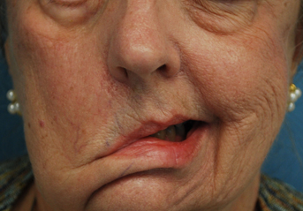
CONSEQUENCES OF LACK OF PROPER NUTRITION
LIFESTYLE DISORDERS
CONSTIPATION
ASTHMA
FASTER AGING
BACK PAINS
JOINT PAINS
INFERTILITY
OBESITY
MIGRANE
FATTY LIVER
OSTEOPOROSIS
HEART ATTACK
PARALYSIS

Slide 19
APPROACH TOWARDS HEALTH
Careful approach for a vehicle you can always buy, but a Careless approach
for the Health you can never buy
“Take care of your body, It’s the only place
You have to Live” - Jim Rohn

Slide 20


How to bring back the optimal health ?
The Only Answer
is
Nutritional Supplements
Remove Toxins
by
Detoxification
OPTIMAL HEALTH
Fulfil the Nutritional
Deficiency with Dietary
Supplements

Slide 21
Now you also can live
LONG & HEALTHY

Slide 22
Why Sami Direct
Trusted
Tested
Proven

Slide 23





Slide 24

DR. MUHAMMED MAJEED
A VISIONARY & THE ARCHITECT OF SAMI DIRECT
Obtained his degree in Pharmacy in 1973.
MS in Industrial Pharmacy from Long Island University, New York
in 1975.
PhD in Industrial Pharmacy from St John's University, New York.
Worked with Pfizer Inc, Carter-Wallace and Paco Research.

Slide 25



Slide 26


Slide 27


Slide 28



Slide 29



Slide 30


Slide 31


Slide 32









SAMIDIRECT – Presenting Ayurveda in the STANDARD DOSAGE FORM
When diet is wrong, medicine is of no use.
When diet is correct, medicine is of no need.
~ Ayurvedic Proverb

Slide 33


Slide 34



Alarming Facts
India - diabetes capital of the world. Every 5th diabetic in the world is an Indian.
World Health Organization estimates that by 2015, 60 % of the cardiac patients in the world will be Indian.
The percentage of overweight people in India is on track to rise from 9% in 1995 to 24% in 2025

Slide 35
Alarming Facts
Walking - decreased by 60%.
Exercise and Jogging - decreased by 60%
Games and sports as recreational activities reduced by 70%
Low activity entertainment such as mobile games, computers, DVD use has SHOT up
Desk job increased by 80%

Slide 36
Quest for Wellness
Gym
Surgery
Drugs
Weight loss clinics
Yoga

Slide 37

Change Your Breakfast, Change Your Life
Prevent Diabetes, Obesity, & Heart Diseases

Slide 38






Why do we need Food ?
ENERGY
VITAMINS
MINERALS
AMINO ACIDS
PHYTO NUTRIENTS
ANTIOXIDENTS
MACRO NUTRIENTS
MICRO NUTRIENTS
1. To give ENERGY for our CELLS during the DAY.
2. To REPAIR & REGENERATE our CELLS at NIGHT

Slide 39


Slide 40





Breakfast – The most important meal of the Day !!
ENERGY
Which is the most important meal of the day?
VITAMINS & MINERALS TO CREATE AND REPAIR OUR CELLS
MACRO NUTRIENTS
MICRO NUTRIENTS

Slide 41




It is time for breaking the Fast !!!
Our body wakes up in the morning and demands 46 essential nutrients …
IN THE FORM OF
CARBOHYDRATES

Slide 42




















% of Calories from INDIAN FOODS
71.7%
87.6%
66.5%
93.3%
92.6%
90.1%
92.6%
77.8%
80% Calories from Carbs
66.7%
71.8%

Slide 43
Carbohydrates-filled breakfast is the cause of …
Average Indian Breakfast Contains 500 to 700 Calories.
70-80% Energy in our breakfast is from carbohydrates.

Slide 44




Daily Cycle of Fat Storage
Glucose
Insulin
High
Blood Sugar
High Insulin levels (no FBZ created)
High Insulin levels (no FBZ created)
Excess calories stored as fat.
Excess calories stored as fat.
Low
Blood Sugar
Dependency on Carbs for hunger
Dependency on Carbs for hunger
Breakfast
Morning Snack
Lunch
Snack

Slide 45





Two Kinds of Body Fat

Slide 46


Visceral Fat – a Toxic Asset

Slide 47


Slide 48






Slide 49








Proteins from Indian Breakfasts
< 25% of Daily Protein Requirement

Slide 50



Too Little Protein Means Muscle Loss
Protein is not stored in the body as such, unlike fat (in fat cells) and glucose (in muscle or liver). Because muscles, for example, are built from protein, we need to consume, and synthesize, enough protein to maintain healthy, hard-working muscles.
Recommended Dietary Allowance (RDA) for Protein Daily Protein Intake.
A minimum daily intake of protein is about 1.2 grams per kilogram of body weight

Slide 51





Our daily ‘normal’ BREAKFAST
EXCESSES
Salt, sugar, fats, calories, carbohydrates
Vitamins & minerals,
protein, fiber, water
DEFICIENCIES

Slide 52


Ideal Breakfast
Supplies vital nutrients for energy (macronutrients).
Not increase in the blood sugar and insulin levels.
Helps avoid dependence on carbs during the day.
Ensures that appetite stays under control.
Restore the (micronutrients) spent in the night.

Slide 53



LEANGARD PROTEIN DRINK MIX
DI BLEND*

Slide 54


Reason-1 Contains Maximum Nutrients
46 Essential Nutrients
Nutrition is what our body needs on a daily basis to stay healthy.
MACRO NUTRIENTS FOR ENERGY DURING DAY
MICRO NUTRIENTS FOR CELL REPAIR DURING NIGHT

Slide 55



LeanGard Protein Drink (IDEAL MEAL)

Slide 56



Reason-2 Contains Minimal Calories
180 Calories Complete Nutrition
92.3 K-Cal
250 ml

Slide 57


Natural Fat Burning Zone with LeanGard Protein Drink
Normal Food
Glucose
Insulin
High Blood Sugar
IDEAL BREAKFAST FOR THE DIABETICS TOO.
Low Blood Sugar
Breakfast
Fat Burn Zone
LUNCH
DINNER
FFA from fat cells released for energy.

Slide 58










Reason-4 Most Affordable Costing
180 CALORIES
LeanGard
Protein Drink
provides Reduced Calories with Maximum Nutrition
65/Serving
870 CALORIES

Slide 59


It is not what you eat that counts
It is what your body absorbs that counts
DI BLEND*

Slide 60
Reason-5 Maximum Bioavailability
Digestive Intolerance Blend – DIB*
Ingredient | Function
Protease | Improves protein digestion Prevents protein allergy/intolerance
Lactase | Improves digestion of milk sugar, lactose Beneficial for lactose intolerant individuals
LactoSpore® | Prevents infection in the gut Probiotic (Reduces load on the kidneys)
DI BLEND*

Slide 61
How LactoSpore® reduces the load on the kidneys
Proteins are made up of amino acids.
After digestion Amino acids are converted to nitrogenous waste.
The toxic nitrogenous waste must be removed from the body by the kidneys.
LactoSpore® contains probiotics.
These bacteria (probiotics) feed on the nitrogenous waste to grow, thus reducing the load on the kidneys for excretion of nitrogen.

Slide 62

Benefits of LeanGard Protein Drink Mix
Ideal breakfast to start the day.
Increases lean body mass.
Helps in weight management.
Increases satiety & controls hunger.
Prevents lactose intolerance.
Enhances protein digestion.
Reduces the load on the kidneys.
Helps to maintain good gut health.
Provides easily absorbable minerals.
Decreases the serum cholesterol and triglyceride levels.
Reduces the rise of blood glucose level following a meal.

Slide 63












Slide 64



Slide 65

Importance of drinking Water
2 glasses – After waking up; activate internal organs.
1 glass – Before taking bath; lowers blood pressure.
3 glasses – 1 glass 30 minutes before each meal; digestion.
1 glass – before sleep; avoid stroke or heart attack.
3 to 5 glasses – anytime thru out the day; to clean body and remove waste.
We require 1 liter of water for every 20 kgs of body weight.

Slide 66





According to the Royal Society of Medicine (England) more than 65% of different health problems are caused by TOXIC COLONS

Slide 67


